Slide 1
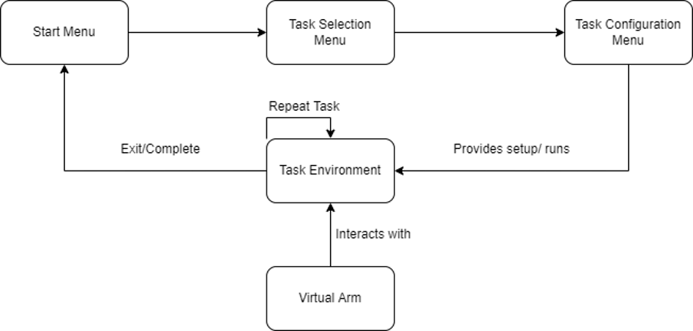
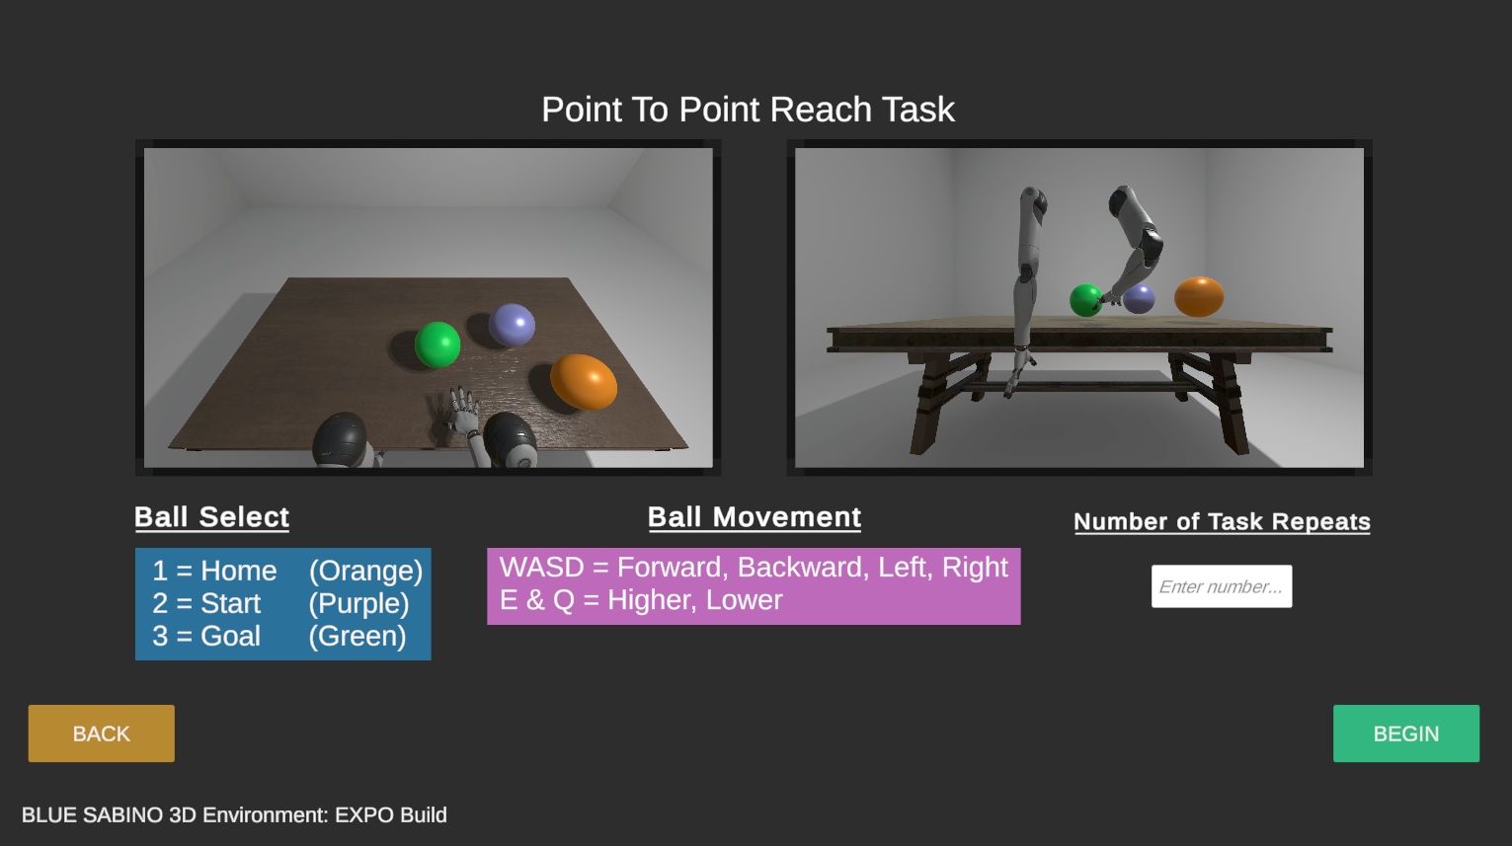
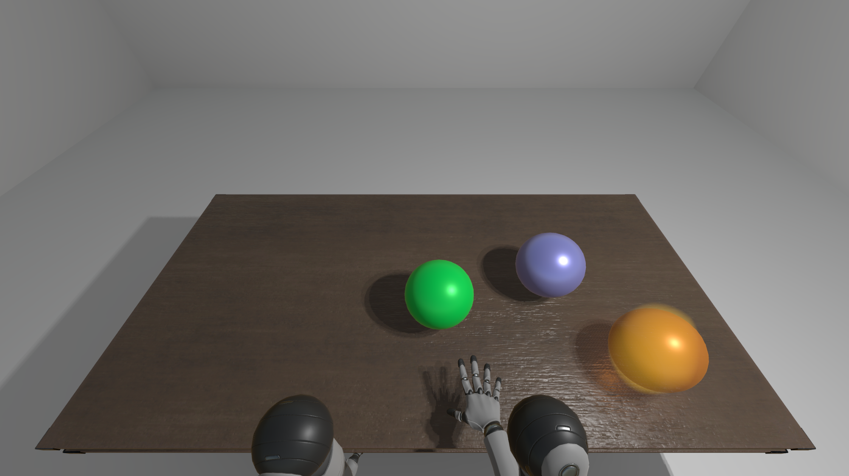
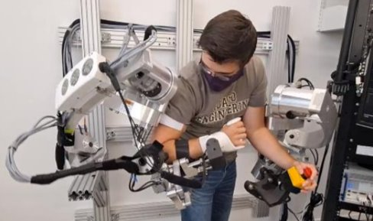
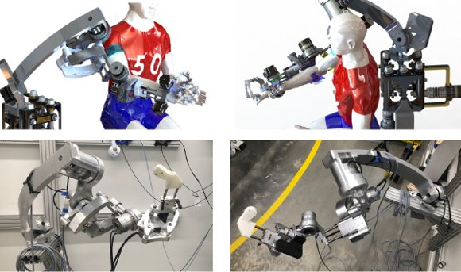
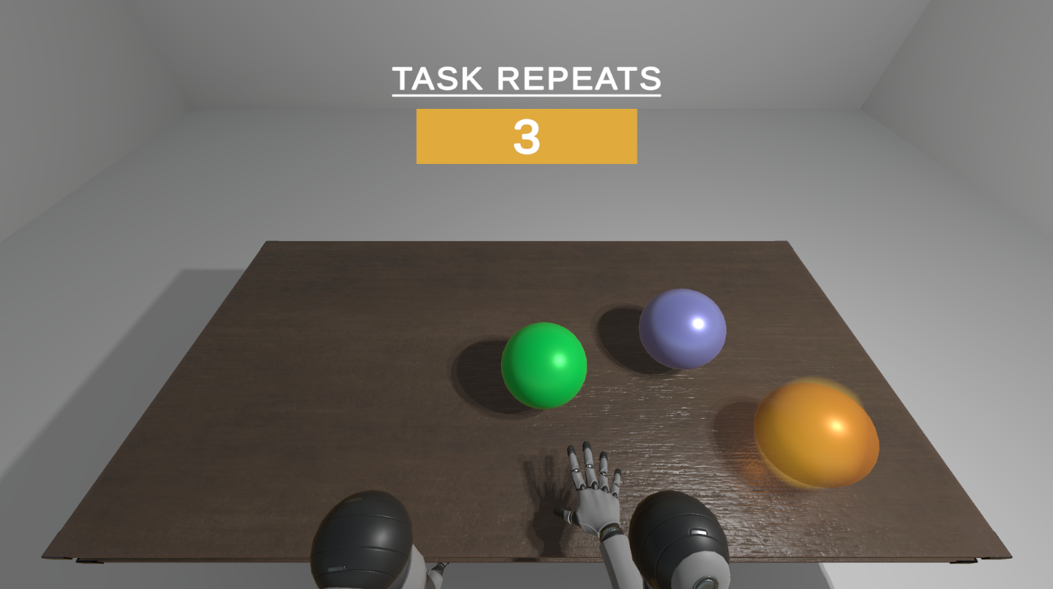
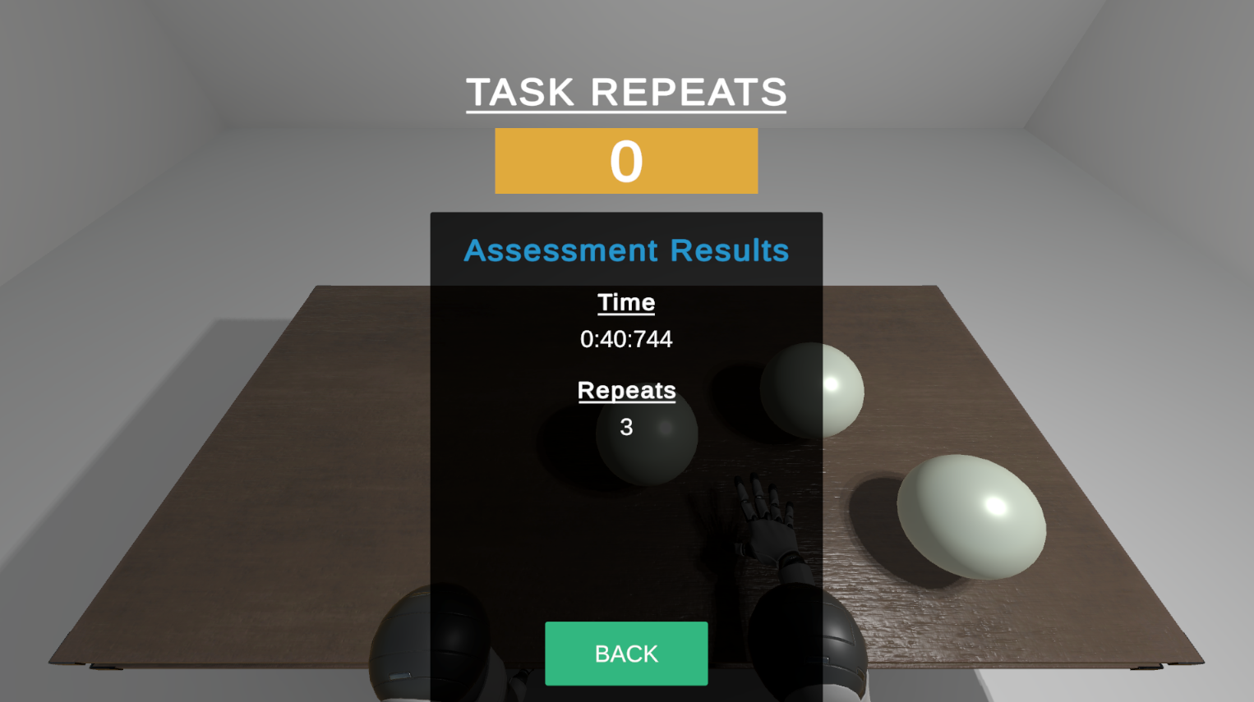

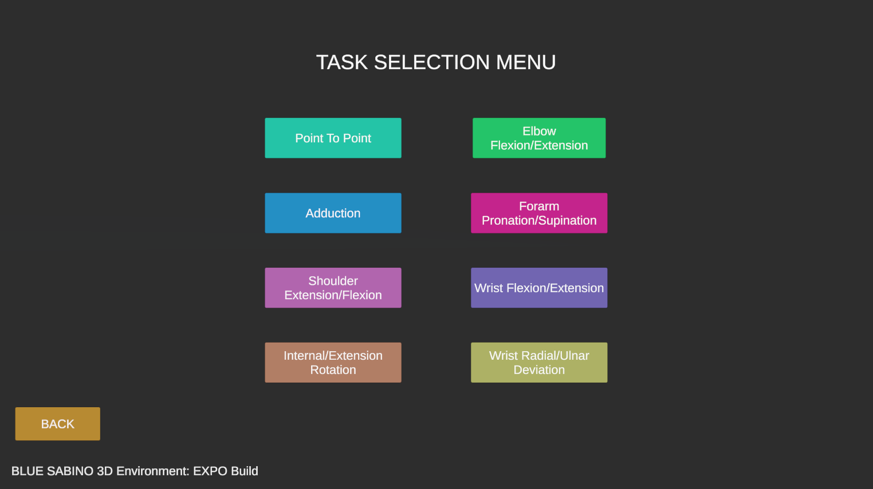
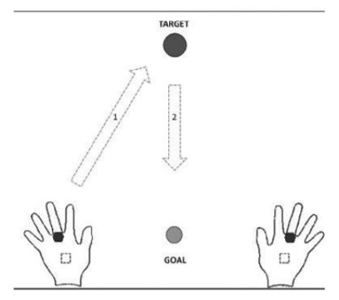

Video Game Environment​ for Arm Assessment through a ​Robotic Exoskeleton​
Miguel Villanueva, Alex Peña, Dawson Hill
Project objective
Create a three-dimensional configurable task environment for the BLUE SABINO where subjects can be presented with consistent and repeatable task guidance and feedback for arm assessment.
Concept development
Concept Overview Diagram
validation
Eventual Shift from Hardware Focused to Software Focused
Originally Developed for Testing, our Virtual Arms Have Now Become Representative of the BLUE SABINO
Heavy Research into the Best Way to Implement our Task System, which Involved Passing and Storing Data; all While Keeping our Environment Intuitive and Modular
Tasks Repeat for a Specified Number of Times and Maintain Their State Until The Assessment is Over
Home, Start, and Goal Positions are Moveable which Expands the Variation and Configurability of Tasks
One Main Task and 7 Individual Joint Movement Tasks
Use of Shadows and Lighting for Depth Perception
Each Virtual Arm Can Utilize Up to 9 Joints Which Surpasses Current Builds of the Physical BLUE SABINO
Project Background
The BLUE SABINO (Bi-Lateral Upper-limb Exoskeleton for Simultaneous Assessment of Biomechanics and Neuromuscular Output) is a robotic exoskeleton being developed by the University of Idaho Assistive Robotics Lab.
Built in Series of Phases (from 2 to 30 Joints, 15 per arm)
Measures Arm and Hand Function in Individuals with Neurological Impairment, Such as Those Who Suffer From Stroke
Records Joint Position Information to Report on Things Such as Range of Motion, Control of Motion, Range of Force, and Control of Force
Final design
Summary AND conclusions
Our project requirements have been fulfilled and we hope the Assistive Robotics Lab can utilize our environment for arm assessment in the future. Additionally, we believe their work on capturing the output from the BLUE SABINO would be easy to add into the project as per the modularity of our design.
recommendations
Main Point-to-Point Reach Task (Involves Multiple Joints)
7 Other Tasks Showcasing Individual Joint Movements
Assessment Results Screen
Implemented with Possible Future Development in Mind
Value proposition
Research and Educational Purposes
Providing Clear and Repeatable Tasks Is a Current Challenge
Insufficient Auditory Cues or Visual Demonstrations
Utilizing a Game Engine To Make
a Capable Task Environment
If the Project Advances into a Marketable Product, the Addition of Quality-of-Life Settings would be good (e.g., screen resolution)
Adding BLUE SABINO Information to the Assessment Results
Acknowledgements
Project requirements
NSF Award #1532239, Funding
The Dean and Cindy Haagenson Endowment, Funding
Dr. Joel Perry, Client
Bruce Bolden, Lead Instructor
Consistent and Repeatable Tasks
Configurable Task Settings
Point-to-Point Reach Task
Clear Communication of On-Screen Objects
Virtual Arm can Modularly use Multiple Joints

